Slide 1
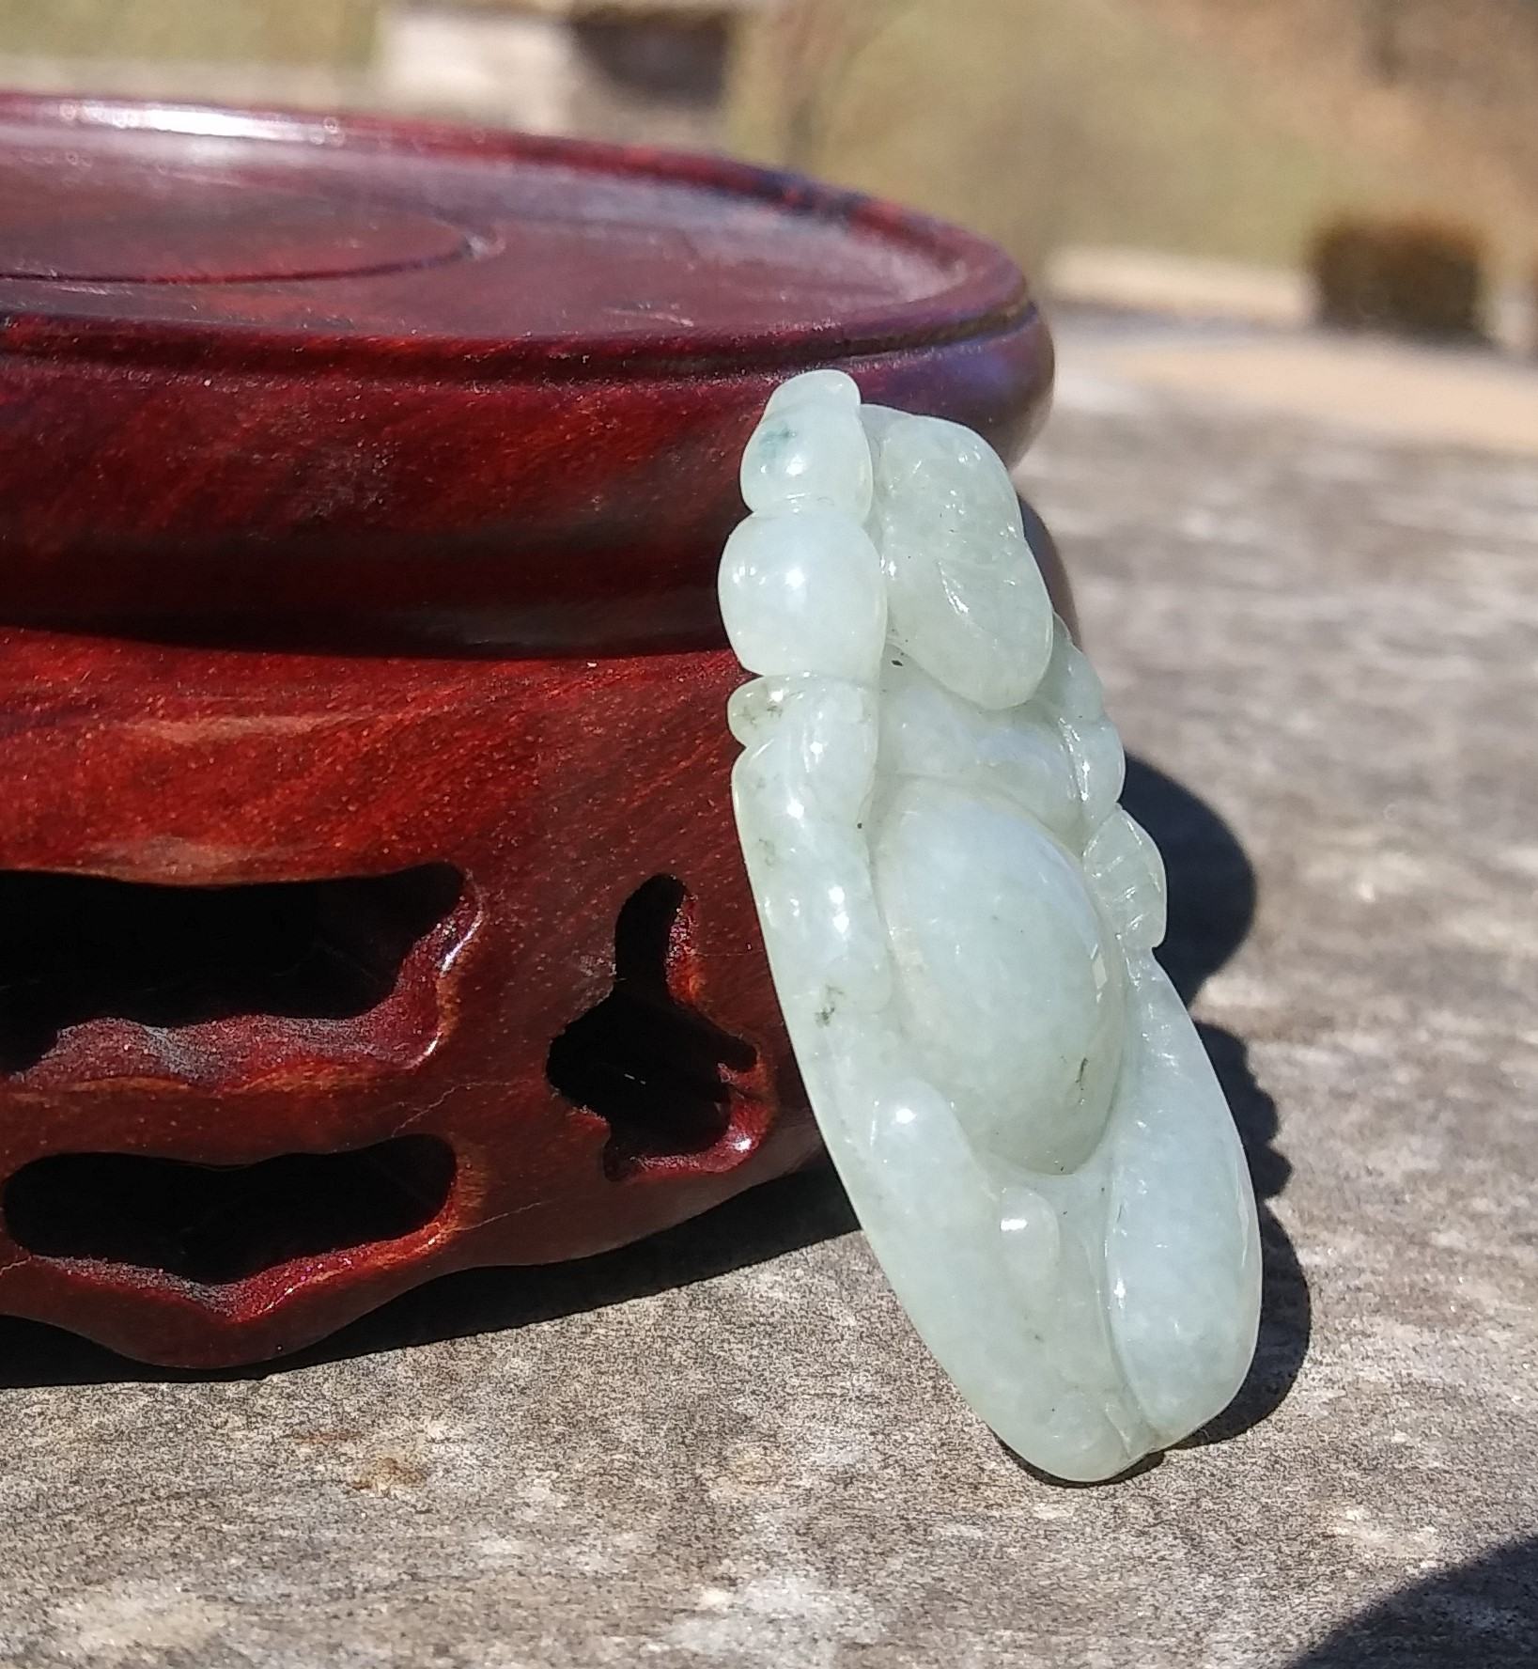
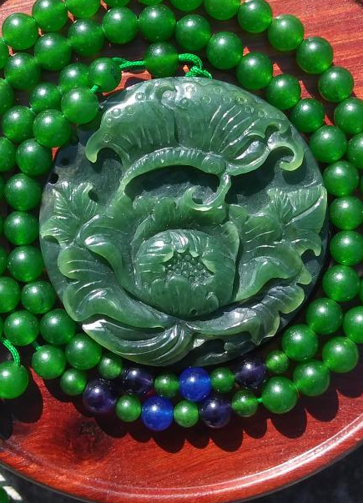
Location Recommendation for Jadeite Jade Jewelry Store in St. Louis County, MO, United States Aaron L. Warsaw July 20, 2019

Slide 2
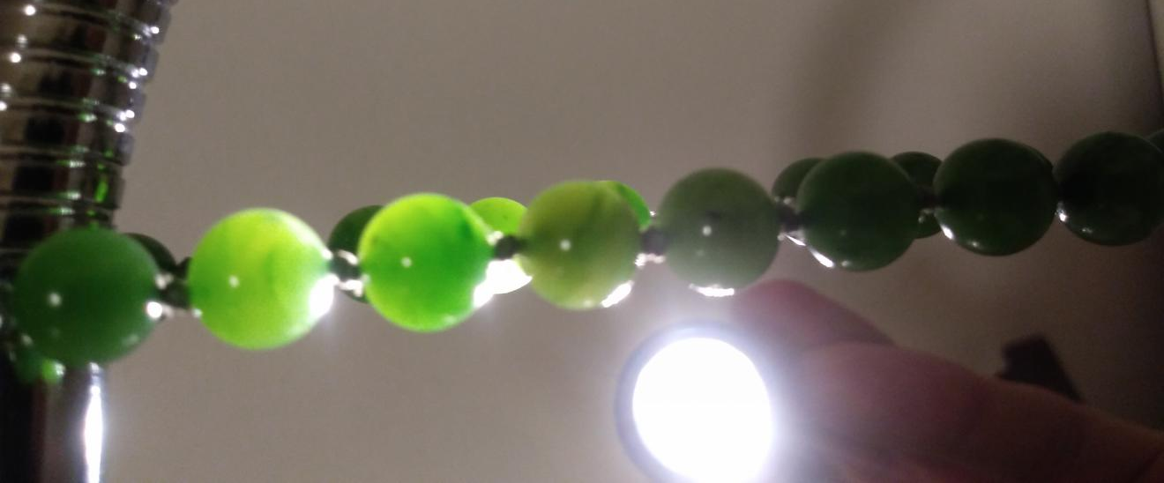
Introduction
Jadeite and nephrite two gemstones correctly called jade by international gem and jewelry industry.
High Quality Jadeite can be more expensive per carat than diamond
Cultural history and significance in:
Asia
North and Central America
New Zealand

Slide 3
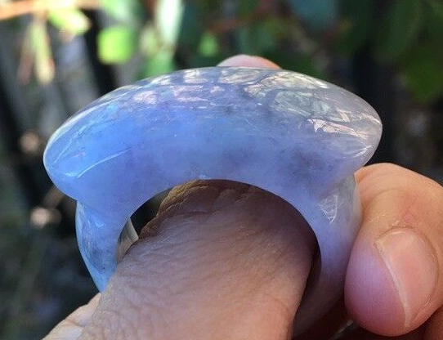
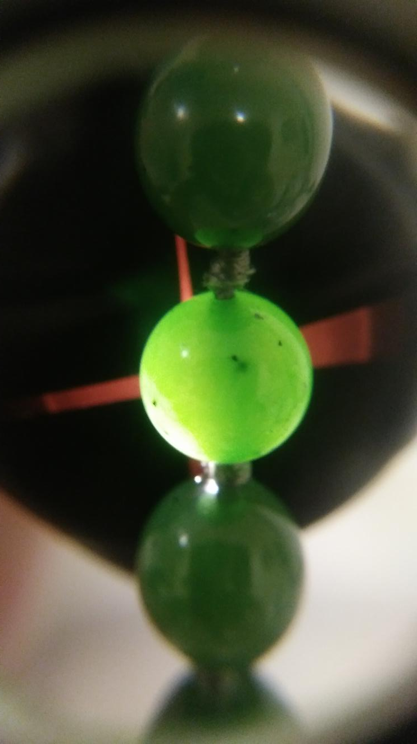
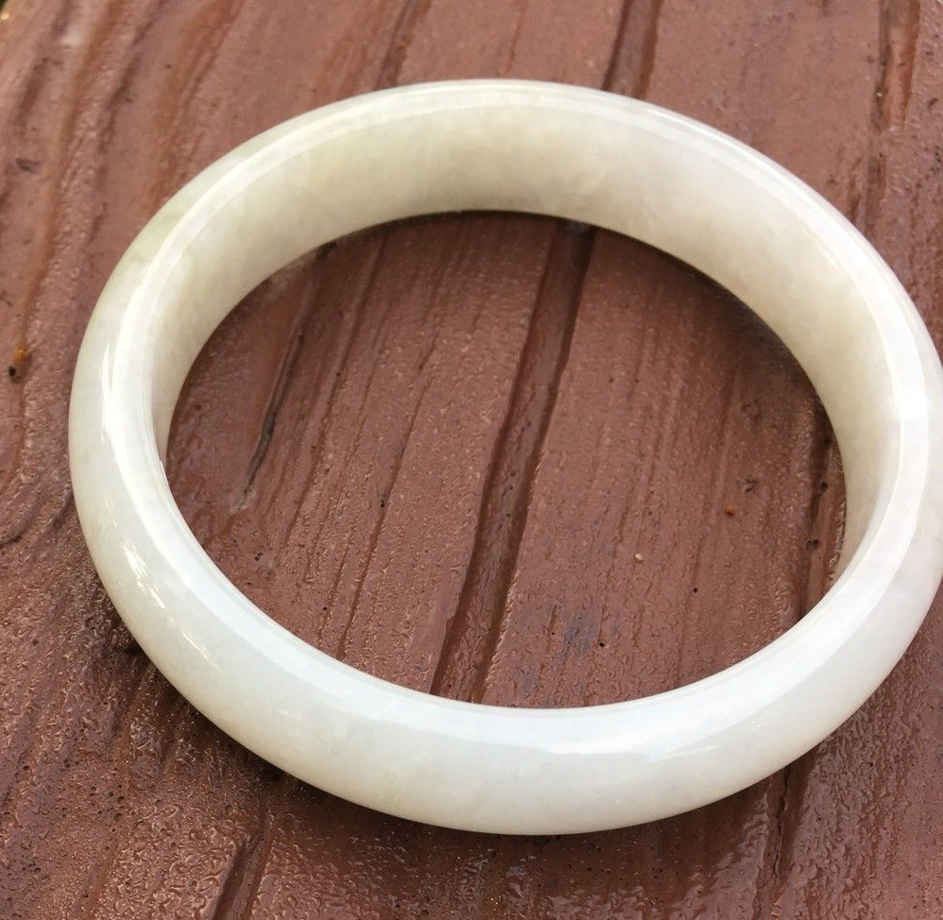
Introduction
Jadeite jade comes in colors besides green, including:
White
Black
Lavender
Yellow
Blue

Slide 4
Introduction: Business Problem
Primary market for high quality jadeite is people of Asian race and ethnicity
I am interested in opening an online and possibly a jewelry store specializing in jadeite jade in the Saint Louis metro area of Missouri, United States.
Businiess Problem and question: Where in St. Louis County should I locate my physical jadeite store and does a market for jadeite even exist in this area?

Slide 5
Introduction
I am the shareholder and person interested in this data analysis project.
If there is not a sizable market and I do not locate my jadeite store close to that market the business will likely fail.
I also want to locate the store in a safe area, area with good employment, and an area with other high end retail goods(these characteristics will be analyzed in the future).

Slide 6
Introduction
This analysis will focus on:
Using FourSquare API to return venues for the postcodes within St. Louis County.
Clustering using unsupervised learning K-means algorithm for clustering post codes in St. Louis County
Obserbational study of Asian race and ethnicty demographics from an online source.

Slide 7
Data Aquisition
All cities and zip codes in St. Louis County, MO were obtained at: (https://www.zip-codes.com/county/mo-saint-louis.asp) by copying and pasting into a Microsoft Excel file.
All zip codes and their corresponding latitude and longitude coordinates for the United States were downloaded at: (www.pier2pier.com/links/files/Countrystate/USA-Zip.xls).
Maps and figures from: https://statisticalatlas.com/county/Missouri/St-Louis-County/Race-and-Ethnicity#data-map/tract were captured as screenshots and pasted into this report.

Slide 8
Methodology: Data Pre-Processing
Installed needed Libraries in a Jupyter notebook.
Excel file containing zip codes and city names was read into the Jupyter notebook and converted into a Pandas data frame.
The column name of zip codes was changed to “Postcode” to match the column name of “Postcode” in the data set of all United States postcodes.
The Excel file containing all United States postcodes was read into the Jupyter notebook as a csv file and converted into a data frame.
New data frame made with postcodes for state of Missouri only
Data frame with all postcodes for St. Louis County and data frame with all postcodes and latitude and longitude coordinates of the state of Missouri were merged on “Postcode” resulting in one data frame with the latitude and longitude coordinates for each postcode in St. Louis County, Missouri.

Slide 9
Methodology: Mapping
Geocoder was used to get latitude and longitude coordinates of the State of Missouri with output reading: “The geographical coordinates of the state of Missouri, US are 38.7604815, -92.5617875”.

Slide 10
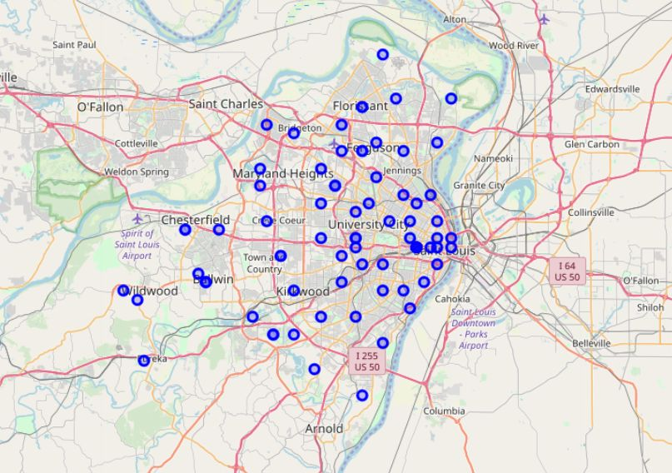
Methodology: Mapping
Folium was used to create a map showing all the postcodes in St. Louis County, MO, United States .
Foursquare version and credentials defined for searching venue information and clustering.
Means of each frequency of venue per postcode was calculated and top five types of venues in each postcode were displayed.
Constructed data frame showing top 10 most common types of venues in each postcode.
The top 10 data frame will be combined with the clustering data frame following clustering.

Slide 11
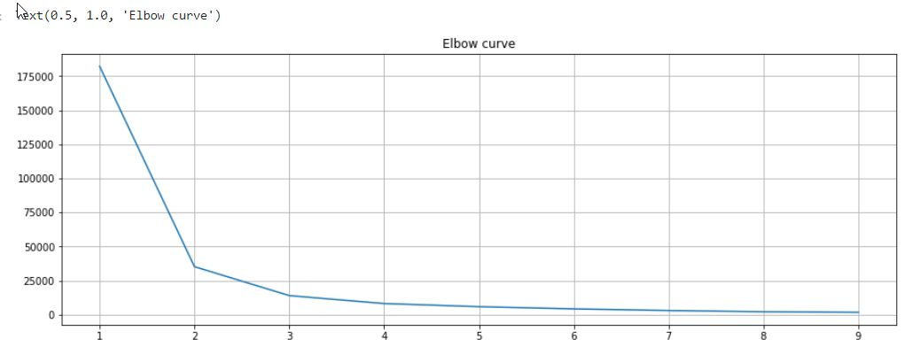
Methodology: K-Means Clustering
Elbow method used to construct a graph to determine the optimal number of clusters (K). X axis = number of K, Y axis = Distortion
Optimum K value at 2 or 3 at the “elbow” of the line. Value of 3 chosen to give a greater variety of clusters.

Slide 12
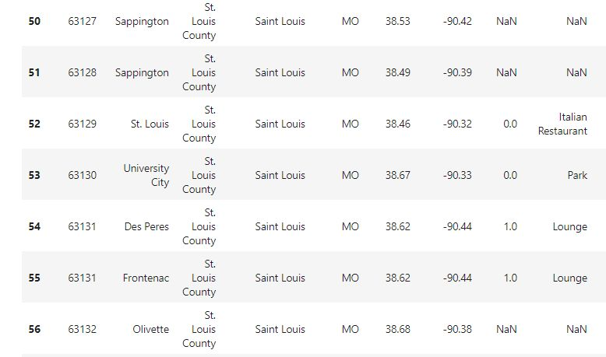

Methodology: K-Means Clustering
Output showing postcodes with NaN values for venues and cluster numbers.
These postcodes were deleted from analysis.

Slide 13
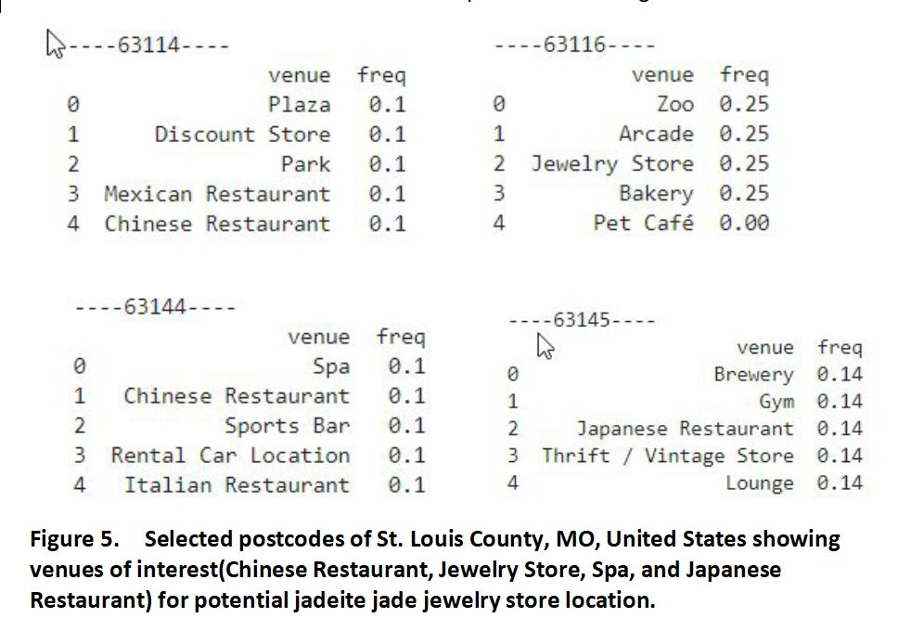
Results
Venues of interest from FourSquare API search for postcodes in St. Louis County.

Slide 14
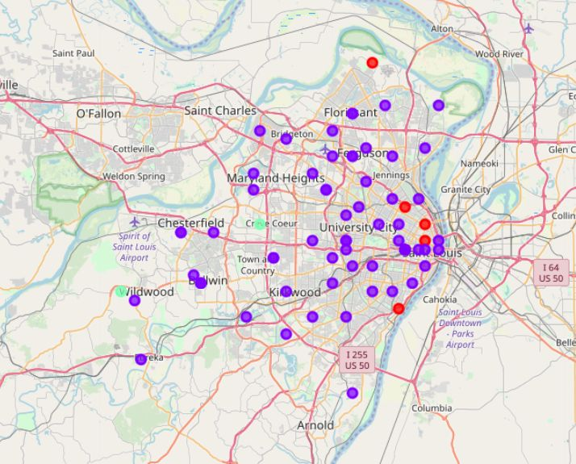
Results
Map of 3 clusters from K-Means clustering of postcodes in St. Louis County.
Note: two bluish green points by Creve Coeur and Wildwood can be hard to see.
Clusters were spread over a wide area.
Clusters contained a large variety of venue types such that clusters were not named
No clusters had venues that indicate large market potential for my jadeite store.

Slide 15
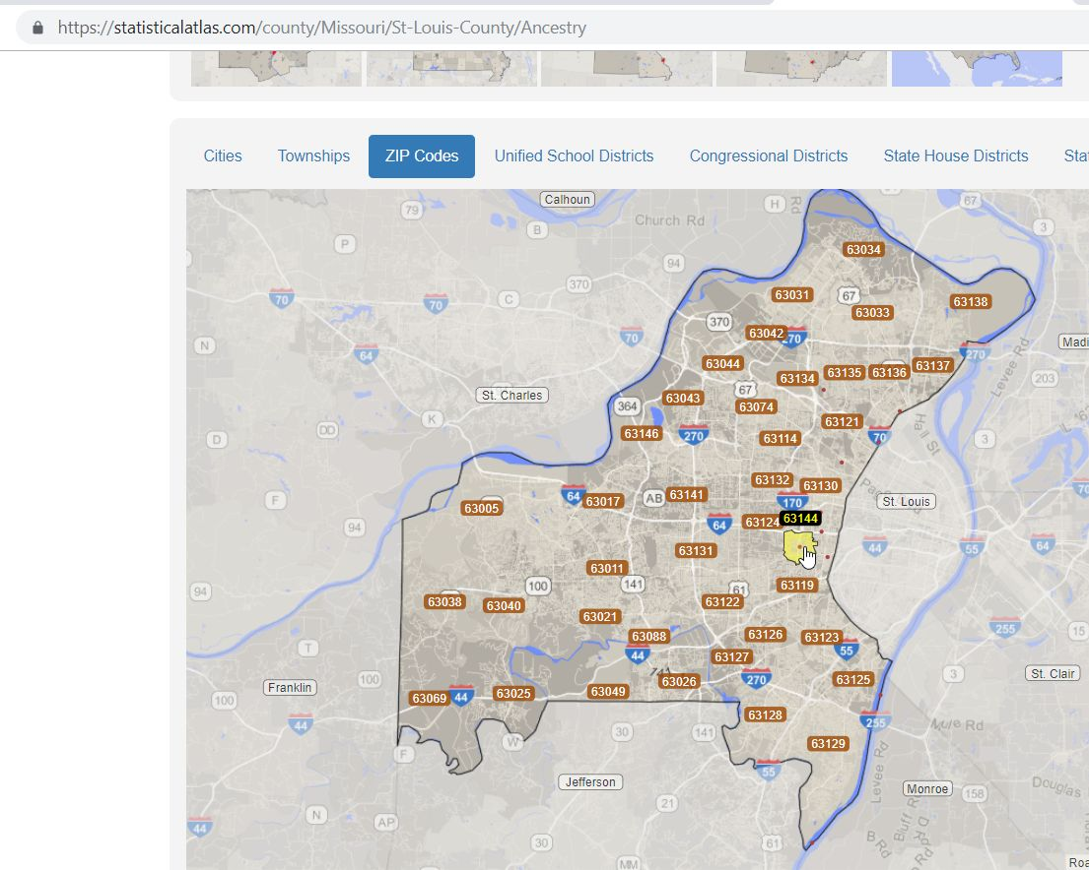
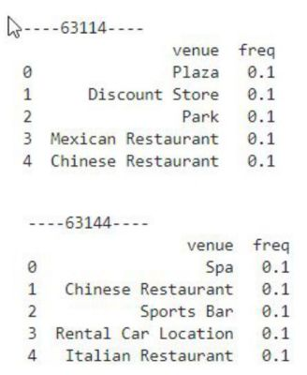
Results
Looking at post codes 63114(Breckinridge Hill) and 63144(Brentwood) location.
Zip codes are close together so this is an area to investigate further as a potential location for my store based on venue type shown.
Map is from: https://statisticalatlas.com/county/Missouri/St-Louis-County/Ancestry
Accessed July 22, 2019).

Slide 16
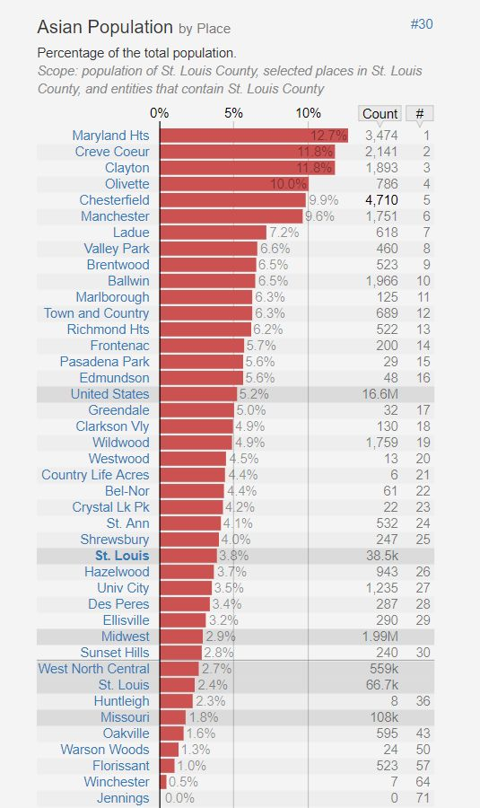
Results
Bar Chart showing Asian population as a percent of the population in selected places of St. Louis County.
Chart from: https://statisticalatlas.com/county/Missouri/St-Louis-County/Race-and-Ethnicity, Accessed July 23, 2019).
Post codes of interest:
63114(Breckinridge Hill) Does not appear on the chart.
63144(Brentwood) 9th on the chart with population of 6.5%
Evidence that these postcodes may not have the target market I am looking for.
Next, look at the locations of the areas with the highest Asian populations.

Slide 17
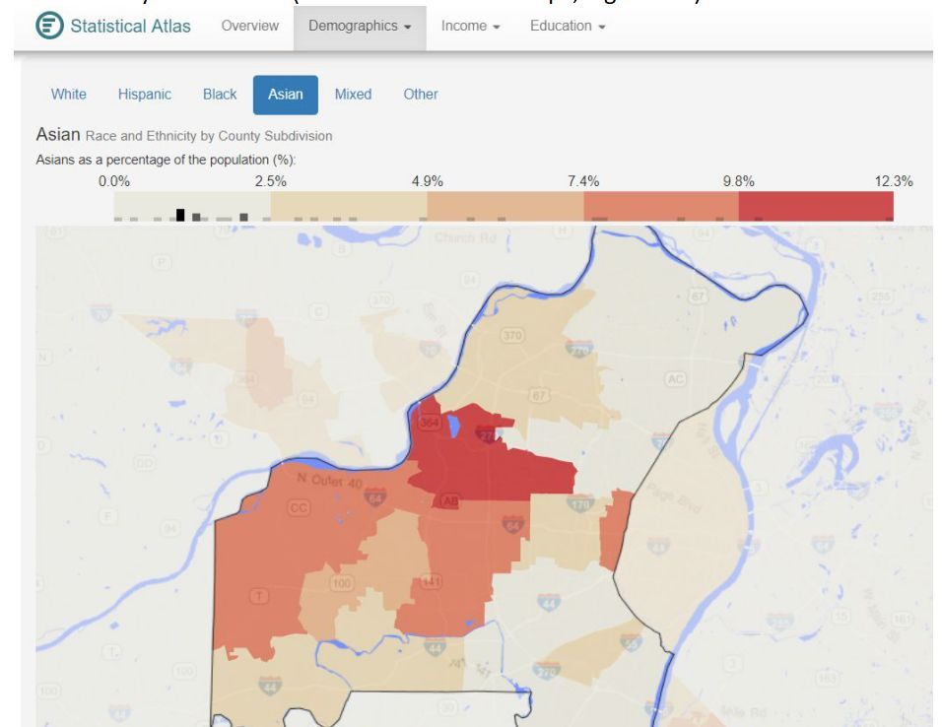
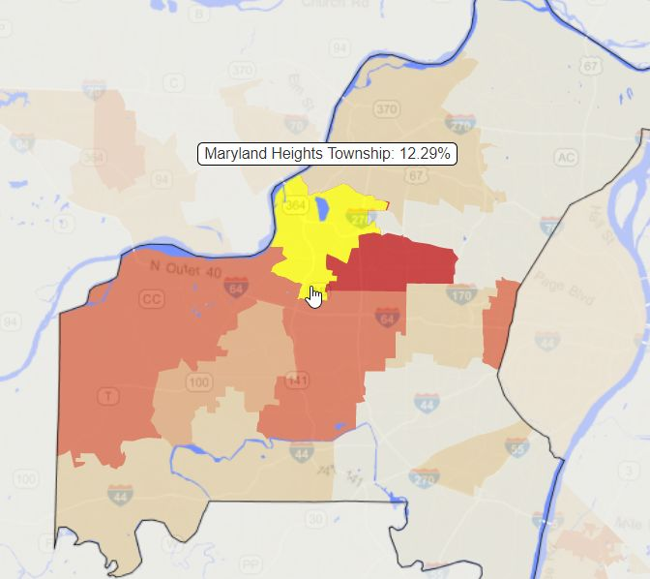
Results
Right Map: Asian race and ethnicity by county subdivision.
Lower Left Map: Yellow area is Maryland Heights Township and a central location to higher Asian population and potential location for my jadeite store.
Maps from: https://statisticalatlas.com/county/Missouri/St-Louis-County/Race-and-Ethnicity, Accessed July 23, 2019).

Slide 18
Conclusions
Searching FourSquare API by venues for postcodes in St. Louis and Clustering by K-means did not reveal definitive locations for a jadeite jade jewelry store.
Asian race and ethnicity demographics for St. Louis County show that the southern area of Maryland Heights Township is a central area for higher percentage of Asain population in St. Louis County and is a location to research further as a potential location for jadeite jewelry store.
Future research will focus on clutering the postcodes of St. Louis as a city by a radius smaller than 500 meters
The area of Olivette and University City needs further research due to personal knowledge of many Asian restaurants and stores along Olive BLVD.

